Slide 1

Camelina Yield Prediction Using Regression Techniques
Biplav Timalsina
Dhurba Neupane

Slide 2
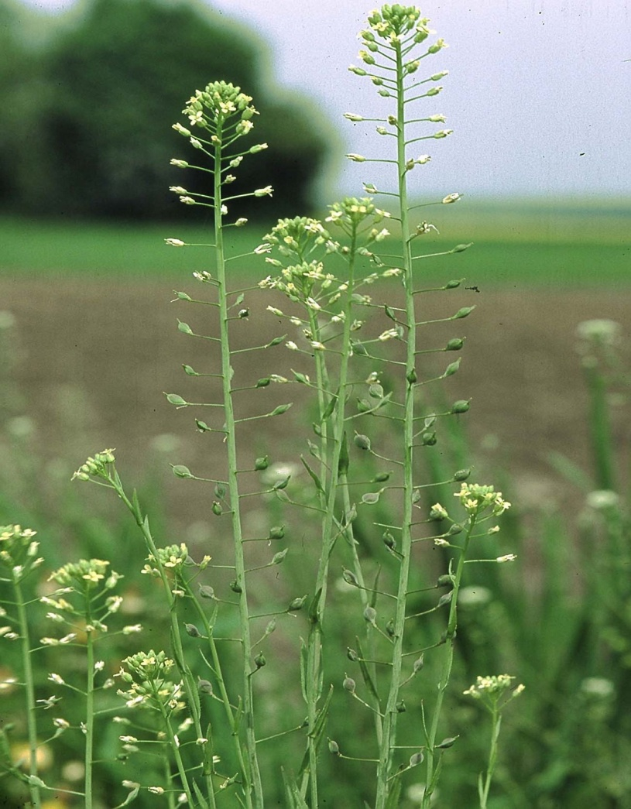
Outline
Background
Hypothesis & Objective
Data
Statistical Analysis
Results, Discussions and Validation
Fake Data
Take-Away
References

Slide 3
Background
Finding a suitable alternative crop for semiarid agriculture can be a challenging task.
However, finding a viable alternative crop is extremely important for agriculture ecosystem like Nevada, where groundwater levels are diminishing due to decline in water allocation for agriculture production.
One such crop suitable for dryland agriculture is camelina sativa, an oil seed crop belonging to the family Brassicaceae.

Slide 4
Why Camelina
Favorable agronomic traits of camelina namely:
Low water use,
Low N requirements
Ability to grow under different climatic and soil conditions.
These traits make this crop suitable for dryland agriculture(Zubr, 2003; Frohlich and Rice, 2005; Pilgeram et al., 2007; Obeng and Obour, 2015).

Slide 5
Hypothesis and Objective
Hypothesis:
Do different Nitrogen rates, block, Nsource and Block have significant effect on seed yield?
Objective:
To evaluate the effects of nitrogen source and rate on seed yield of camelina sativa.

Slide 6
Data
Predictor
Block (1,2,3,4) : Categorical
Cultivar(Blaine Creek, Pronghorn) : Categorical
Nsource(N1,N2) : Categorical
Nrate (N00,N40,N80,N120): Categorical
Year(2016/17): Categorical
Output variables:
Seed-yield (Continuous)
Block 1 | Block 2
Block 3 | Block 4
KGs of Nitrogen per hectare
N1: Conventional Urea
N2: Sulphur Coated Urea

Slide 7
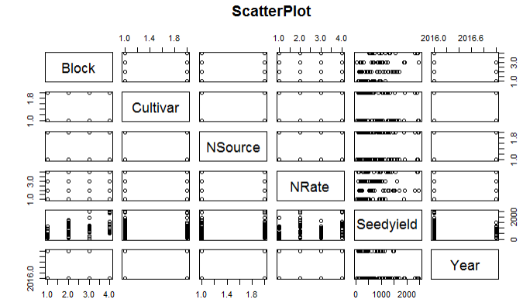
Analysis

Slide 8
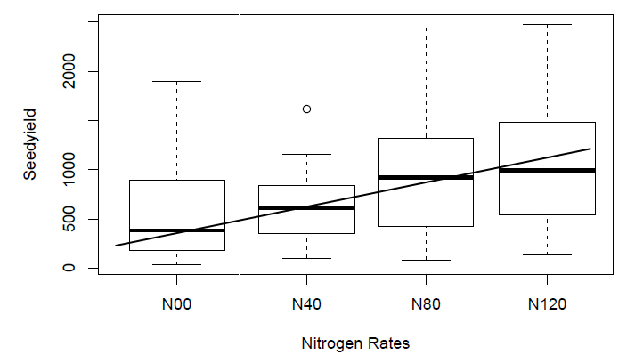
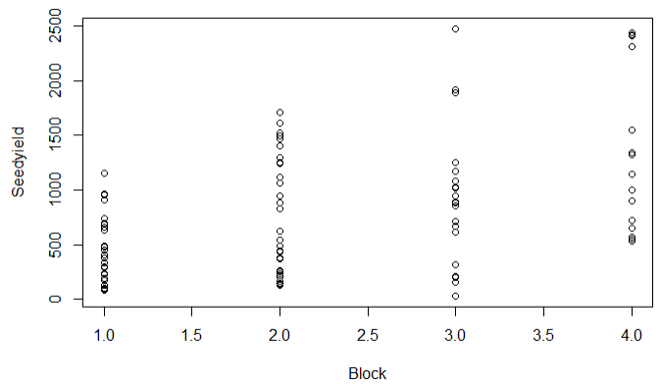
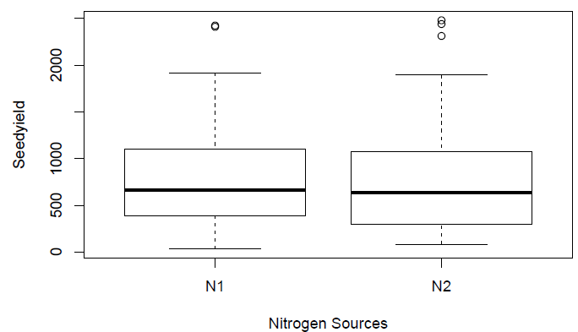
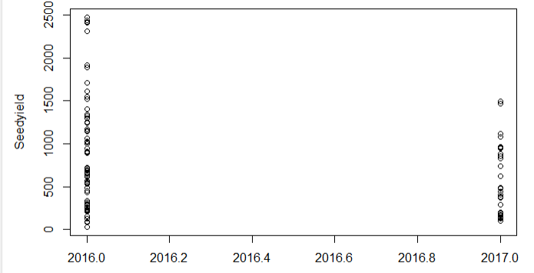
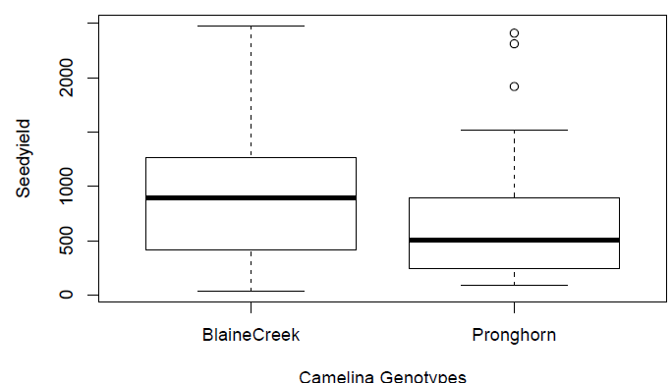
Analysis

Slide 9
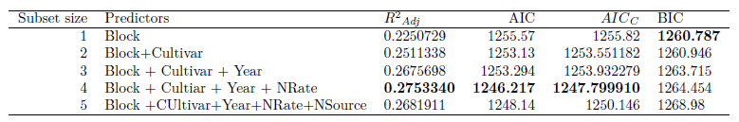
Model Development
All Possible Subsets
Final Model:
Yield= 480353.88 + 185.47*Block -265.64*CultivarProghorn -238.1*Year
+ 407.64* Nrate120 + 60.48*NRate40 + 376.31* NRate80

Slide 10
Model Development: Log Likelihood Ratio Test
Models | Terms | -2log-Lik | Chi-square | df | p-value
1 | Block2+Block3+Block4+BlainCreek+N40+N80+N120+N2+2017 | -962.0409
 | Model1-Block2-Block3-Block4 | -974.52 | 24.96 | 1 | 5.8e-07
 | Model1-BlaineCreek | -967.51 | 10.94 | 1 | 0.00094
 | Model1-Year | -962.041 | 0.002 | 1 | 0.964
 | Model1-NRate | -971.59 | 19.1 | 1 | 1.23e-05
 | Model1-N2 | -962.042 | 0.0022 | 1 | 0.962
2 | Block2+Block3+Block4+BlainCreek+N40+N80+N120+N2 | -962.041
 | -Model 2 - Block | -978.19 | 31.95 | 1 | 1.5e-08
 | -Model 2- BlaineCreek | -971.51 | 18.94 | 1 | 1.34e-05
 | -Model 2- N40-N80-N120 | -975.46 | 26.84 | 1 | 2.2e-07
 | -Model 2- N2 | -966.47 | 8.86 | 1 | 0.0029
Seed yield: 134.28 + 265.63*BlaineCreek + 406.24 *N120 +61.54*N40 +380.9* N80-8.02*N2 + 205.1685 *B2 + 417.38*B3+546.41*B4

Slide 11
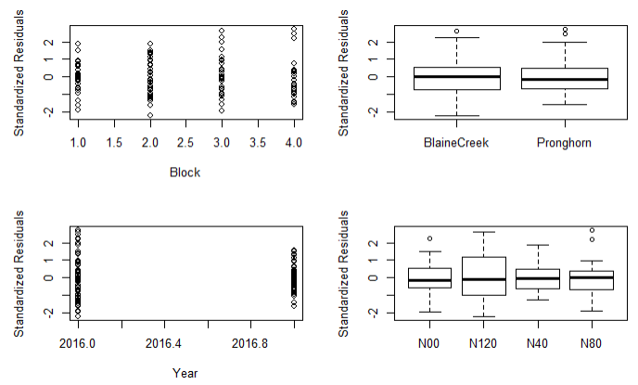
Validation

Slide 12
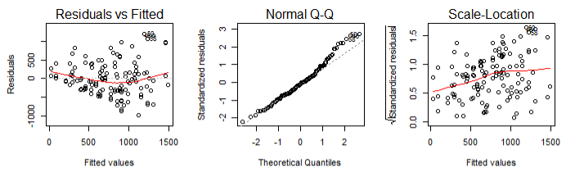
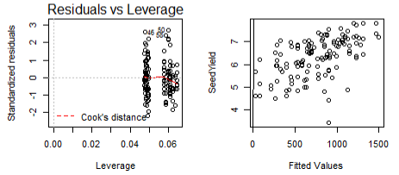
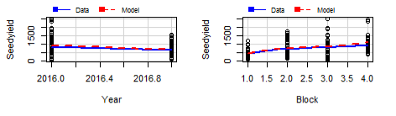
Leverage= 2(p+1)/n, p=4, n=128
Leverage=0.078
➔ No leverage points, but some outliers

Slide 13
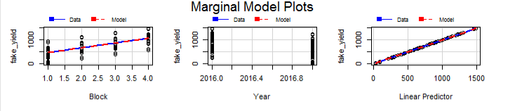
Fake Data

Slide 14
Conclusion & Questions
Camelina seed yield increases as the Nrate increases, and it shows a linear pattern.
There was no significant effect of nitrogen sources on seed yield.
Camelina cultivars Blaine Creek produced greater seed yield compared to cultivar Pronghorn.
Since we have two years data, we would do autocorrelation techniques to see if our data really show good fit.
Performing mixed effect model would be appropriate method as we have fixed(Nitrogen rates, nitrogen source and cultivars) and random (Block, year) effect.

Slide 15
References
Frohlich, A. and Rice, B., 2005. Evaluation of Camelina sativa oil as a feedstock for biodiesel production. Industrial Crops and Products.21:25-31.
Jiang, Y., C.D. Caldwell, K.C. Falk, R.R. Lada, and D. MacDonald. 2013. Camelina yield and quality response to combined nitrogen and sulfur. Agron. J. 105: 1847–1852.
Malhi, S.S., E.N. Johnson, L.M. Hall, W.E. May, S. Phelps, and B. Nybo. 2014. Effect of nitrogen fertilizer application on seed yield, N uptake, and seed quality of Camelina sativa. Can. J. Soil Sci. 94: 35–47.
Obeng, E. and Obour, A. 2015. Seeding Date Effects on Camelina Seed Yield and Quality Traits. Kansas Agricultural Experiment Station Research Reports, 1(2). Available at: http://dx.doi.org/10.4148/2378-5977.1030.
Pilgeram A.L., D.C. Sands, D. Boss, N. Dale, D. Wichman, P. Lamb, C. Lu, R. Barrows, M. Kirkpatrick, B. Thompson, D.L. Johnson. 2007. Camelina sativa, a Montana omega-3 fatty acid and fuel crop. In: J. Janick, A. Whipkey (eds.) Issues in new crops and new uses. ASHS Press, Alexandria, pp 129–131
Sintim, H.Y., V.D. Zheljazkov, A.K. Obour, A. Garcia y Garcia, and T.K. Foulke. 2015. Evaluating agronomic responses of Camelina to seeding date under rain-fed conditions. Agron. J. 108: 349–357.
Zubr, J. 2003. Qualitative variation of Camelina sativa seed from different locations. Ind. Crops Prod. 17:161–169.
Sheather, S.J,2007. A Modern Approach to Regression with R. Textbook website: http://www.stat.tamu.edu/~Sheather /book/.

